Slide 1


Enhancing End-to-End Encrypted Messaging: A Hybrid Classical-Post- Quantum Approach with Real-Time Multi- User Support
MrShadow⚡
Notes:
1.7.2013
‹#›

Slide 2



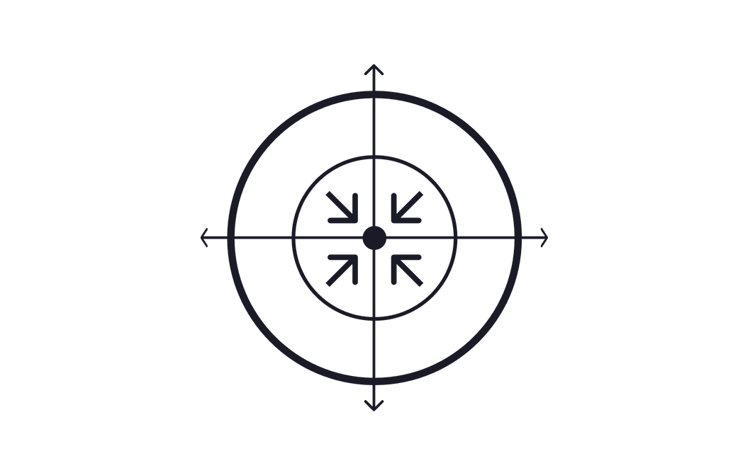
Critical Vulnerabilities in Digital Communication
Traditional Encryption Breakdown
Quantum Risk
Classical algorithms like RSA and AES face existential threats from quantum computers. Shor's algorithm can factor large numbers in polynomial time, while Grover's algorithm halves symmetric key security.
Centralized Failure
MitM Interception
User Experience Gaps
Complex setup processes, limited algorithm flexibility, and poor room management features create friction in secure communication workflows, reducing adoption rates.
Weak Authentication
Modern encryption faces unprecedented threats from quantum computing advances and evolving attack vectors requiring immediate architectural changes.
Notes:
1.7.2013
‹#›

Slide 3
Solution
Comprehensive Quantum-Safe Chat Platform
Post-Quantum Security
Real-Time Collaboration
Scalable Infrastructure
NIST-approved algorithms including Kyber, Dilithium, and Falcon provide quantum-resistant protection. Hybrid encryption combines classical and quantum-safe methods for transitional security.
Unlimited participants, live updates, smart search filtering, and multi-device support deliver seamless communication without compromising security or performance.
Flask-based RESTful API, optimized polling mechanisms, and modular architecture ensure efficient operation with minimal server load and maximum extensibility.
The platform implements end-to-end encryption with room-specific keys derived from user passphrases, ensuring zero-knowledge architecture where even the server cannot decrypt messages.
Notes:
1.7.2013
‹#›

Slide 4


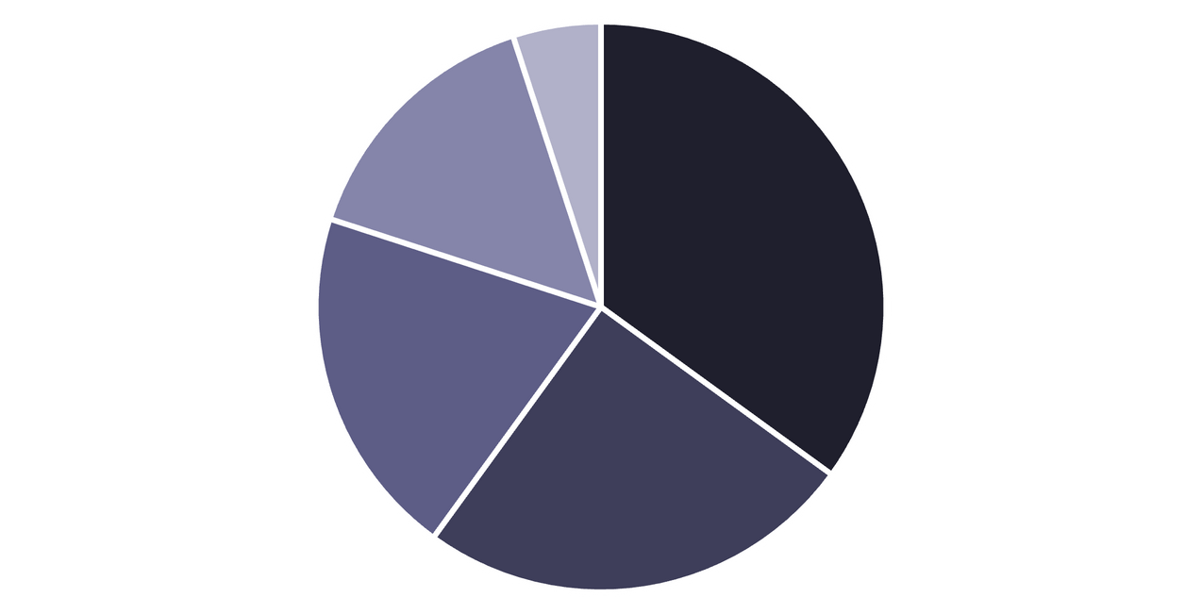
Dependencies and Showstopper
High-Risk Dependencies
Post-Quantum Cryptography: Core security depends on correct PQC implementation. Mitigation uses NIST-approved reference implementations with comprehensive testing protocols.
5
4
1
Secure Randomness: Cryptographically secure random number generation is critical for key derivation. Platform-provided CSPRNG with regular entropy testing ensures unpredictability.
3
2
Major Showstoppers
PQC Libraries
Random Generation
Web Framework
Storage Layer
Browser Support
Algorithm implementation errors compromise security
Memory storage limits scalability and persistence
Real-time bottlenecks degrade user experience
Notes:
1.7.2013
‹#›

Slide 5

Highlights/Difference between exisiting solution
1
2
3
4
Quantum-Resistant Security
Enhanced Room Management
Developer-Friendly Architecture
Premium User Experience
15+ PQC algorithms vs. classical encryption only in traditional apps. Hybrid approach provides transitional security while competitors remain vulnerable to quantum threats.
Unlimited participants with detailed room descriptions, real-time statistics, and advanced search capabilities exceed limitations of Discord, Slack, and WhatsApp.
Modular PQC library, clean frontend/backend separation, extensible API design, and comprehensive documentation streamline integration and customization.
Space-themed UI, current room display, message preservation across rooms, enter key support, and responsive design deliver superior usability.
Notes:
1.7.2013
‹#›

Slide 6

Frontend
Backend
Depolyment
Core Framework: Flask 2.x with Werkzeug WSGI and Jinja2 templating provides lightweight, scalable Python backend.
Core Stack: HTML5 semantic markup, CSS3 animations, and vanilla JavaScript ES6+ eliminate external dependencies.
Vercel
Security Layer: Custom PQC library implements Kyber, Dilithium, Falcon, SABER, Classic McEliece, and 10+ additional quantum-resistant algorithms.
Real-Time Features: Polling architecture with Fetch API delivers HTTP-based updates and event-driven reactive UI.
Design System: Custom space-themed CSS framework with responsive grid layout and mobile-first approach.
Data Management: In-memory storage for development with JSON serialization and UUID-based unique identifiers.
TECH STACK
01
02
03
MVC Architecture
Security Patterns
Performance Optimization
Model-View-Controller separation with repository pattern for data access abstraction
Defense in depth, fail-safe defaults, least privilege access, secure-by-design architecture
Lazy loading, debounced search, virtual scrolling, connection pooling, caching layer
Notes:
1.7.2013
‹#›

Slide 7

Team Name: MrShadow⚡
Name
College Name
College Location
Position
Gender
Valluru Janaka Tejeswar
AITS
TPT
Backend Dev
Male
Uppu Tirumalesh
SISTK
PUTTUR
Team Leader
Male
Pulipati Pradeep Kumar
AITS
TPT
Frontend Dev
Male
Dasari Nani
AITS
TPT
Data Researcher
Male
Shaik Sareen
SISTK
PUTTUR
Technical Writer
Female
Notes:
1.7.2013
‹#›

